Slide 1
Number Theory
Meilin Liu
Department of Computer Science
Wright State University
Homepage: http://www.wright.edu
Email: meilin.liu@wright.edu
Notes:
Zili Shao

Slide 2
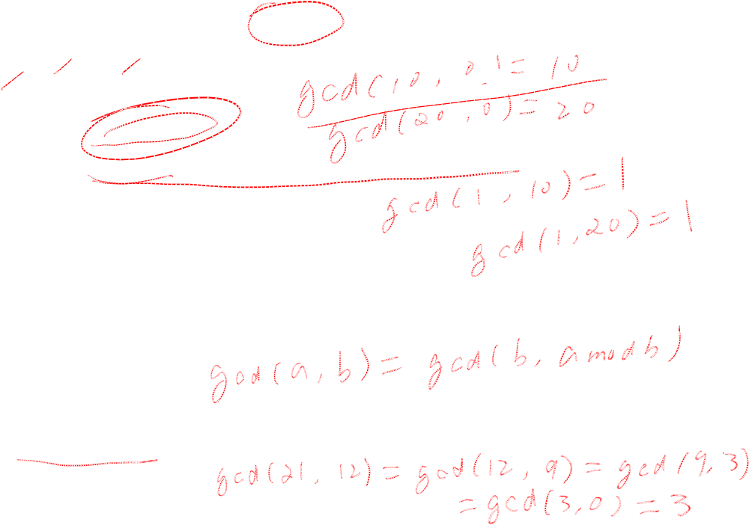
Greatest Common Divisor
Modulo operator for a positive integer n
  r = a mod n
Modulo and GCD:
  Fact 1: gcd (a, 0) =a.
  Fact 2: gcd(a, b) = gcd(b, a mod b), where a >=b.
Illustration: Suppose gcd(a,b)=d, so a=d*a’, b=d*b’
Suppose a=k*b+r,
so a mod b = r, and r =a- k*b = d*a’-k*d*b’= d(a’-k*b’)
So d | a mod b, so d is a common divisor of b and a mod b
Example:
  gcd(21, 12) = 3 gcd(12, 21 mod 12) = gcd(12, 9) = 3
CEG 260, Meilin Liu
Notes:
Zili Shao
All security policies and mechanisms rest on assumptions; we’ll examine some in later chapters, most notably Chapter 22, Malicious Logic. Here is a taste of the assumptions.
Policies: as these define security, they have to define security correctly for the particular site. For example, a web site has to be available, but if the security policy does not mention availability, the definition of security is inappropriate for the site. Also, a policy may not specify whether a particular state is “secure” or “non-secure.” This ambiguity causes problems.
Mechanisms: as these enforce policy, they must be appropriate. For example, cryptography does not assure availability, so using cryptography in the above situation won’t work. Further, security mechanisms rely on supporting infrastructure, such as compilers, libraries, the hardware, and networks to work correctly. Ken Thompson’s modified C preprocessor (see the example on p. 615) illustrates this point very well.

Slide 3

Euclid’s GCD Algorithm
EuclidGCD(a,b):
    1. A←a; B←b
  2. If B=0, return A
    3. R = A mod B
    4.A =←B; B ← R
  5. Goto 2
Euclid’s algorithm for Computing the GCD repeatedly applies the formula
  gcd(a, b) = gcd(b, a mod b)
Example
  gcd(412, 260) = 4
a | 412 | 260 | 152 | 108 | 44 | 20 | 4
b | 260 | 152 | 108 | 44 | 20 | 4 | 0
CEG 260, Meilin Liu
Notes:
Zili Shao
All security policies and mechanisms rest on assumptions; we’ll examine some in later chapters, most notably Chapter 22, Malicious Logic. Here is a taste of the assumptions.
Policies: as these define security, they have to define security correctly for the particular site. For example, a web site has to be available, but if the security policy does not mention availability, the definition of security is inappropriate for the site. Also, a policy may not specify whether a particular state is “secure” or “non-secure.” This ambiguity causes problems.
Mechanisms: as these enforce policy, they must be appropriate. For example, cryptography does not assure availability, so using cryptography in the above situation won’t work. Further, security mechanisms rely on supporting infrastructure, such as compilers, libraries, the hardware, and networks to work correctly. Ken Thompson’s modified C preprocessor (see the example on p. 615) illustrates this point very well.

Slide 4
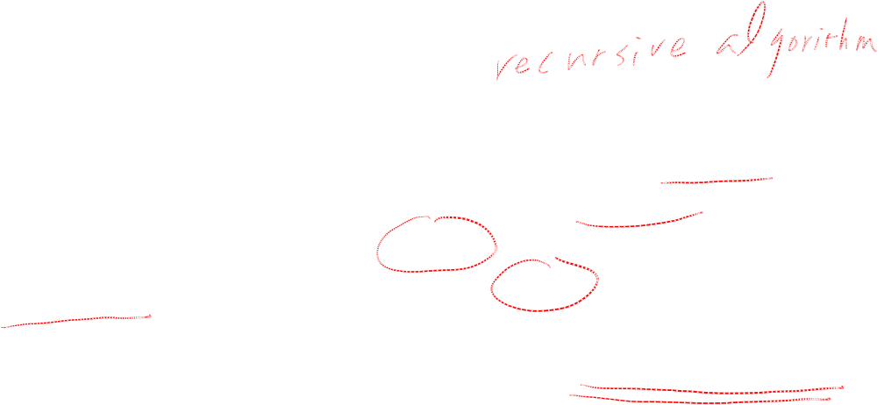

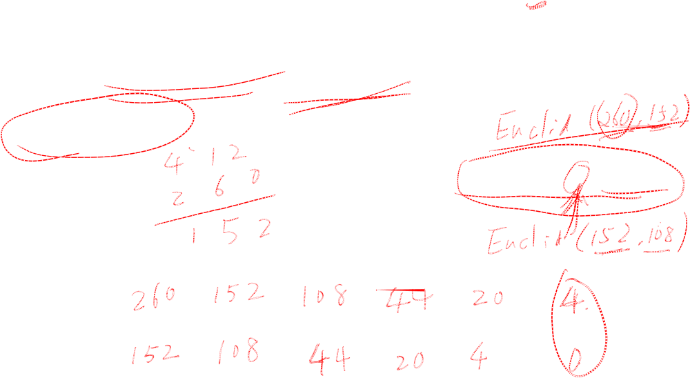
Euclid’s GCD Algorithm
Euclid’s algorithm for Computing the GCD repeatedly applies the formula
  gcd(a, b) = gcd(b, a mod b)
Example
  gcd(412, 260) = 4
Algorithm EuclidGCD(a, b)
Input integers a and b
Output gcd(a, b)
if b = 0
return a
else
return EuclidGCD(b, a mod b)
a | 412
b | 260
CEG 260, Meilin Liu
Notes:
Zili Shao
All security policies and mechanisms rest on assumptions; we’ll examine some in later chapters, most notably Chapter 22, Malicious Logic. Here is a taste of the assumptions.
Policies: as these define security, they have to define security correctly for the particular site. For example, a web site has to be available, but if the security policy does not mention availability, the definition of security is inappropriate for the site. Also, a policy may not specify whether a particular state is “secure” or “non-secure.” This ambiguity causes problems.
Mechanisms: as these enforce policy, they must be appropriate. For example, cryptography does not assure availability, so using cryptography in the above situation won’t work. Further, security mechanisms rely on supporting infrastructure, such as compilers, libraries, the hardware, and networks to work correctly. Ken Thompson’s modified C preprocessor (see the example on p. 615) illustrates this point very well.

Slide 5

Euclid’s Algorithm -- Example
18
10
412
*1
260
*1
10
260
*1
8
*1
152
8
152
*1
*4
2
108
8
108
*2
88
0
44
*2
20
40
*5
20
4
0
CEG 260, Meilin Liu
Notes:
Zili Shao
All security policies and mechanisms rest on assumptions; we’ll examine some in later chapters, most notably Chapter 22, Malicious Logic. Here is a taste of the assumptions.
Policies: as these define security, they have to define security correctly for the particular site. For example, a web site has to be available, but if the security policy does not mention availability, the definition of security is inappropriate for the site. Also, a policy may not specify whether a particular state is “secure” or “non-secure.” This ambiguity causes problems.
Mechanisms: as these enforce policy, they must be appropriate. For example, cryptography does not assure availability, so using cryptography in the above situation won’t work. Further, security mechanisms rely on supporting infrastructure, such as compilers, libraries, the hardware, and networks to work correctly. Ken Thompson’s modified C preprocessor (see the example on p. 615) illustrates this point very well.

Slide 6
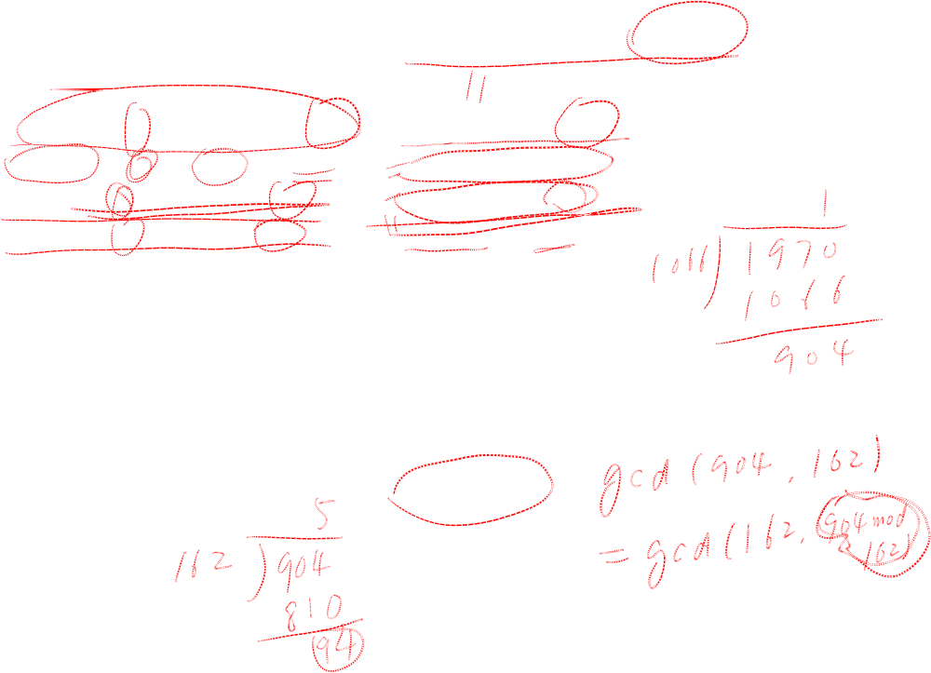
Example -- GCD(1970,1066)
1970 = 1 x 1066 + 904 gcd(1066, 904)
1066 = 1 x 904 + 162 gcd(904, 162)
904 = 5 x 162 + 94 gcd(162, 94)
162 = 1 x 94 + 68 gcd(94, 68)
94 = 1 x 68 + 26 gcd(68, 26)
68 = 2 x 26 + 16 gcd(26, 16)
26 = 1 x 16 + 10 gcd(16, 10)
16 = 1 x 10 + 6 gcd(10, 6)
10 = 1 x 6 + 4 gcd(6, 4)
6 = 1 x 4 + 2 gcd(4, 2)
4 = 2 x 2 + 0 gcd(2, 0)
CEG 260, Meilin Liu
Notes:
Zili Shao
Compute successive instances of GCD(a,b) = GCD(b,a mod b).
Note this MUST always terminate since will eventually get a mod b = 0 (ie no remainder left).

Slide 7
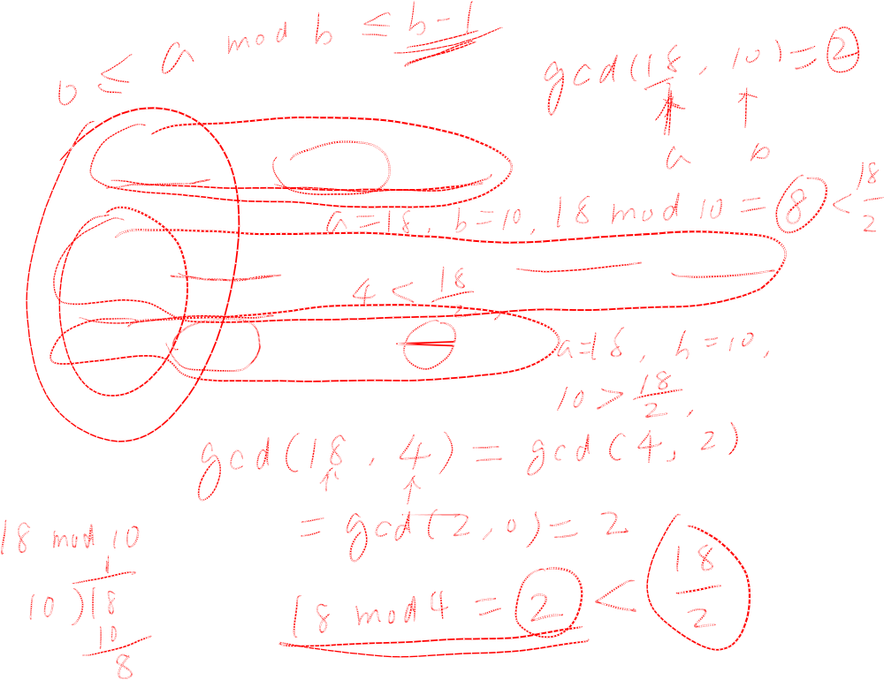
Analysis
Theorem: If a > b, then a mod b < a/2
Proof: Case I: b <=a/2, a mod b must be less than b, b <=a/2,
so a mod b <=a/2
Case II: b >a/2, a mod b = a-b <a/2
  r = a mod n
CEG 260, Meilin Liu
Notes:
Zili Shao
All security policies and mechanisms rest on assumptions; we’ll examine some in later chapters, most notably Chapter 22, Malicious Logic. Here is a taste of the assumptions.
Policies: as these define security, they have to define security correctly for the particular site. For example, a web site has to be available, but if the security policy does not mention availability, the definition of security is inappropriate for the site. Also, a policy may not specify whether a particular state is “secure” or “non-secure.” This ambiguity causes problems.
Mechanisms: as these enforce policy, they must be appropriate. For example, cryptography does not assure availability, so using cryptography in the above situation won’t work. Further, security mechanisms rely on supporting infrastructure, such as compilers, libraries, the hardware, and networks to work correctly. Ken Thompson’s modified C preprocessor (see the example on p. 615) illustrates this point very well.

Slide 8
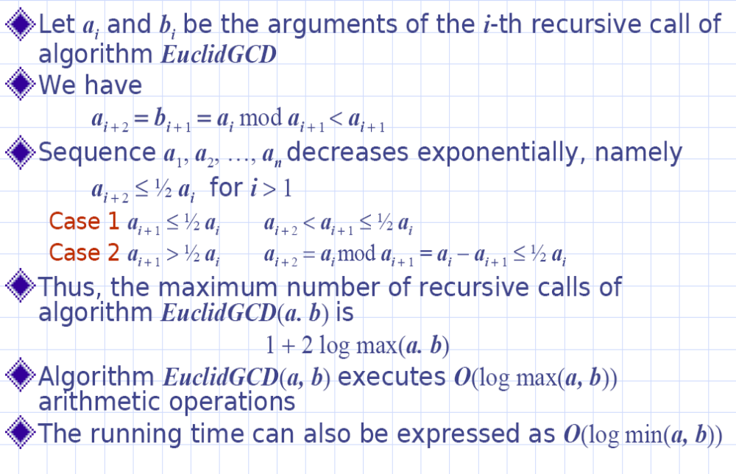
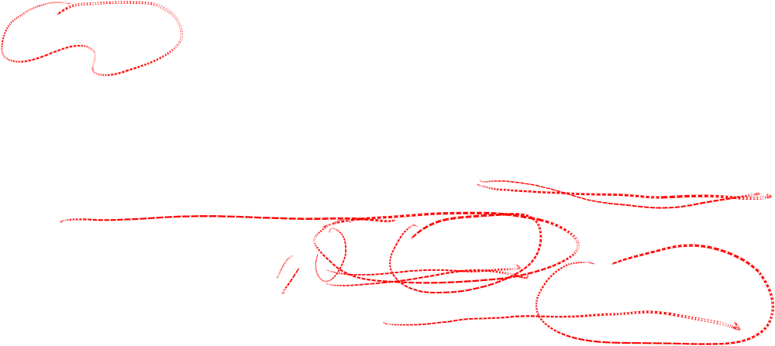
Analysis
CEG 260, Meilin Liu
Notes:
Zili Shao
All security policies and mechanisms rest on assumptions; we’ll examine some in later chapters, most notably Chapter 22, Malicious Logic. Here is a taste of the assumptions.
Policies: as these define security, they have to define security correctly for the particular site. For example, a web site has to be available, but if the security policy does not mention availability, the definition of security is inappropriate for the site. Also, a policy may not specify whether a particular state is “secure” or “non-secure.” This ambiguity causes problems.
Mechanisms: as these enforce policy, they must be appropriate. For example, cryptography does not assure availability, so using cryptography in the above situation won’t work. Further, security mechanisms rely on supporting infrastructure, such as compilers, libraries, the hardware, and networks to work correctly. Ken Thompson’s modified C preprocessor (see the example on p. 615) illustrates this point very well.

Slide 9
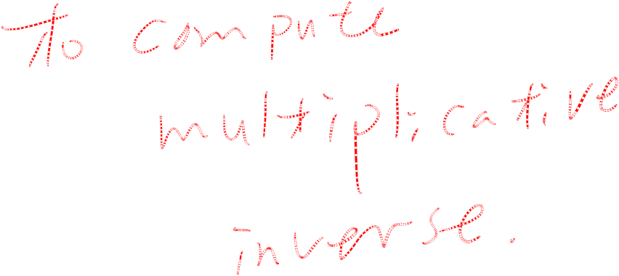
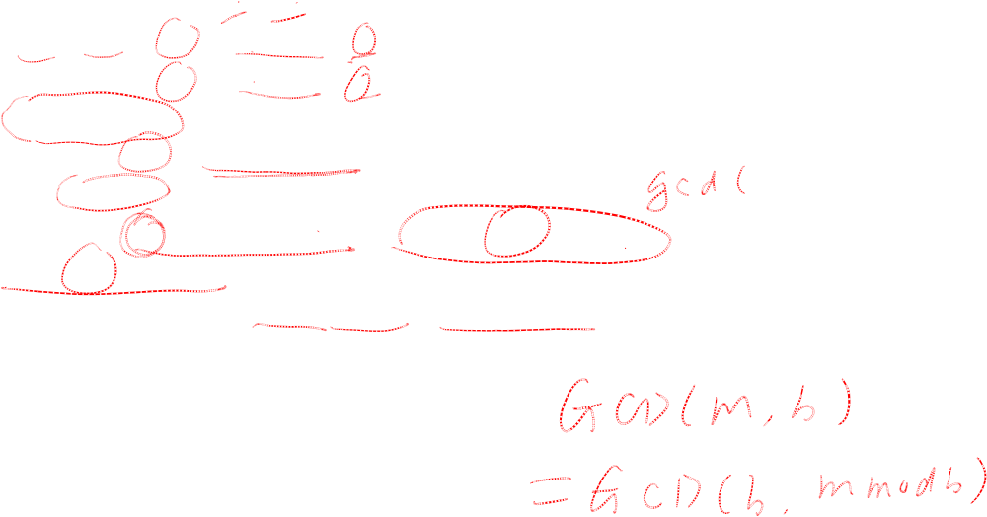
Extended Euclid Algorithm
Extended Euclid’s algorithm:
  EXTENDED EUCLID(m, b)
  (A1, A2, A3)=(1, 0, m);
  (B1, B2, B3)=(0, 1, b)
  2. if B3 = 0
  return A3 = gcd(m, b); no inverse
  3. if B3 = 1
  return B3 = gcd(m, b); B2 = b^{–1} mod m
  4. Q = A3 div B3
  5. (T1, T2, T3)=(A1 – Q B1, A2 – Q B2, A3 – Q B3)
  6. (A1, A2, A3)=(B1, B2, B3)
  7. (B1, B2, B3)=(T1, T2, T3)
  8. goto 2
CEG 260, Meilin Liu
Notes:
Zili Shao

Slide 10
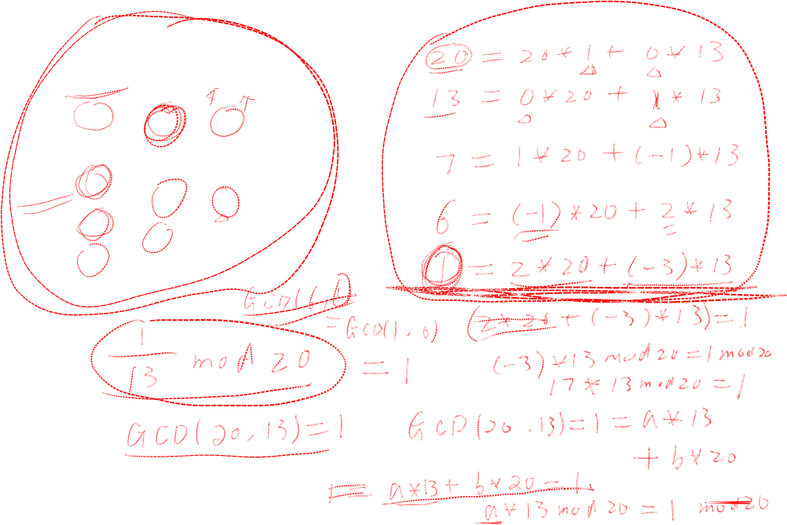
Extended Euclid’s Algorithm -- Example
(1,0)
(0,1)
20
*1
13
13
*1
7
(1,-1)
7
*1
6
(-1,2)
6
*6
6
(2,-3)
1
0
CEG 260, Meilin Liu
Notes:
Zili Shao
All security policies and mechanisms rest on assumptions; we’ll examine some in later chapters, most notably Chapter 22, Malicious Logic. Here is a taste of the assumptions.
Policies: as these define security, they have to define security correctly for the particular site. For example, a web site has to be available, but if the security policy does not mention availability, the definition of security is inappropriate for the site. Also, a policy may not specify whether a particular state is “secure” or “non-secure.” This ambiguity causes problems.
Mechanisms: as these enforce policy, they must be appropriate. For example, cryptography does not assure availability, so using cryptography in the above situation won’t work. Further, security mechanisms rely on supporting infrastructure, such as compilers, libraries, the hardware, and networks to work correctly. Ken Thompson’s modified C preprocessor (see the example on p. 615) illustrates this point very well.

Slide 11
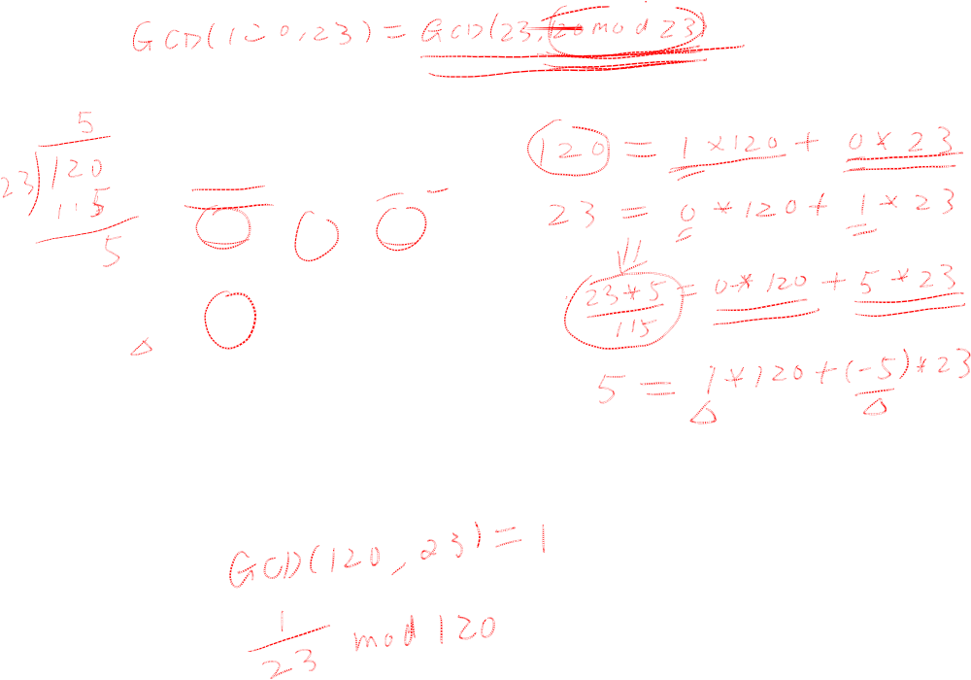
Extended Euclid’s Algorithm -- Example
(1,0)
(0,1)
120
*5
23
115
*4
20
(1,-5)
5
*1
3
(-4,21)
3
*1
2
(5,-26)
2
*1
1
(-9,47)
1
0
CEG 260, Meilin Liu
Notes:
Zili Shao
All security policies and mechanisms rest on assumptions; we’ll examine some in later chapters, most notably Chapter 22, Malicious Logic. Here is a taste of the assumptions.
Policies: as these define security, they have to define security correctly for the particular site. For example, a web site has to be available, but if the security policy does not mention availability, the definition of security is inappropriate for the site. Also, a policy may not specify whether a particular state is “secure” or “non-secure.” This ambiguity causes problems.
Mechanisms: as these enforce policy, they must be appropriate. For example, cryptography does not assure availability, so using cryptography in the above situation won’t work. Further, security mechanisms rely on supporting infrastructure, such as compilers, libraries, the hardware, and networks to work correctly. Ken Thompson’s modified C preprocessor (see the example on p. 615) illustrates this point very well.

Slide 12
Extended Euclid Algorithm
The computation proceeds as follows:
20 = 20 * 1 + 13 * 0
13 = 20 * 0 + 13 * 1
7 = 20 - 13 * 1 = (20 * 1 + 13 * 0) - (20 * 0 + 13 * 1) * 1
= 20 * 1 + 13 * (-1)
6 = 13 – 7*1 = (20 * 0 + 13 * 1) – (20 * 1 + 13 * (-1) )*1
= 20*(-1) + 13*(2)
1 = 7 - 6 = 20 * 1 + 13 * (-1) – {20*(-1) + 13*(2)}
= 20*2 +13*(-3)
1 mod 20 = 13*(-3) mod 20 = 13*17 mod 20
1 mod 13 = 20*2 mod 13
CEG 260, Meilin Liu
Notes:
Zili Shao
All security policies and mechanisms rest on assumptions; we’ll examine some in later chapters, most notably Chapter 22, Malicious Logic. Here is a taste of the assumptions.
Policies: as these define security, they have to define security correctly for the particular site. For example, a web site has to be available, but if the security policy does not mention availability, the definition of security is inappropriate for the site. Also, a policy may not specify whether a particular state is “secure” or “non-secure.” This ambiguity causes problems.
Mechanisms: as these enforce policy, they must be appropriate. For example, cryptography does not assure availability, so using cryptography in the above situation won’t work. Further, security mechanisms rely on supporting infrastructure, such as compilers, libraries, the hardware, and networks to work correctly. Ken Thompson’s modified C preprocessor (see the example on p. 615) illustrates this point very well.

Slide 13
Extended Euclid Algorithm
The computation proceeds as follows:
120 = 120 * 1 + 23 * 0
23 = 120 * 0 + 23 * 1
5 = 120 - 23 * 5
= (120 * 1 + 23 * 0) - (120 * 0 + 23 * 1) * 5
= 120 * 1 + 23 * (-5)
3 = 23 – 5*4
= (120 * 0 + 23 * 1) – (120 * 1 + 23 * (-5) )*4
= 120*(-4) + 23*(21)
2 = 5 - 3 = 120 * 1 + 23 * (-5) – {120*(-4) + 23*(21)}
= 120*5 +23*(-26)
1= 3 - 2 = 120*(-4) + 23*(21) – {120*5 +23*(-26)}
= 120* (-9) + 23*47
CEG 260, Meilin Liu
Notes:
Zili Shao
All security policies and mechanisms rest on assumptions; we’ll examine some in later chapters, most notably Chapter 22, Malicious Logic. Here is a taste of the assumptions.
Policies: as these define security, they have to define security correctly for the particular site. For example, a web site has to be available, but if the security policy does not mention availability, the definition of security is inappropriate for the site. Also, a policy may not specify whether a particular state is “secure” or “non-secure.” This ambiguity causes problems.
Mechanisms: as these enforce policy, they must be appropriate. For example, cryptography does not assure availability, so using cryptography in the above situation won’t work. Further, security mechanisms rely on supporting infrastructure, such as compilers, libraries, the hardware, and networks to work correctly. Ken Thompson’s modified C preprocessor (see the example on p. 615) illustrates this point very well.

Slide 14
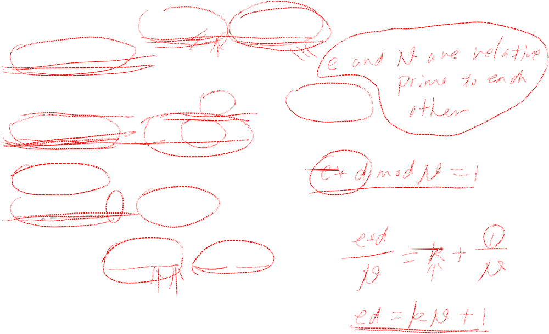
Extended Euclid Algorithm – Finding Multiplicative Inverse
e*d = 1 mod N Given N, e, Gcd(e,N)=1, find d,
d= 1/e mod N
e*d = 1 mod N ➔ e*d =k*N+1 ➔ k*N=e*d-1
e*d -k*N=1 ➔ e*d +k’*N=1
Gcd(e,N)=1
e*d +k’*N=1 = Gcd(e,N),
In general: GCD(a,b)=m*a+n*b
CEG 260, Meilin Liu
Notes:
Zili Shao
All security policies and mechanisms rest on assumptions; we’ll examine some in later chapters, most notably Chapter 22, Malicious Logic. Here is a taste of the assumptions.
Policies: as these define security, they have to define security correctly for the particular site. For example, a web site has to be available, but if the security policy does not mention availability, the definition of security is inappropriate for the site. Also, a policy may not specify whether a particular state is “secure” or “non-secure.” This ambiguity causes problems.
Mechanisms: as these enforce policy, they must be appropriate. For example, cryptography does not assure availability, so using cryptography in the above situation won’t work. Further, security mechanisms rely on supporting infrastructure, such as compilers, libraries, the hardware, and networks to work correctly. Ken Thompson’s modified C preprocessor (see the example on p. 615) illustrates this point very well.

